Slide 1
Big Dig Day: What’s the dirt?
Notes:
Hello! I’m so glad to join you today to give you some highlights of our upcoming Big Dig Day social media campaign!
I hope to give you the information you need to take advantage of this opportunity to raise needed funds for your programs.
So—let’s dig in!

Slide 2
What’s the dirt on Big Dig Day?
SAVE THE DATE
First time campaign across all of UC ANR
An “all hands on deck,” 24 hour fundraising program.
Running our own, stand-alone giving day.
Notes:
What’s the dirt on Big Dig Day? It’s our first ever independent campaign across all UC ANR Programs.
It’s an “all hands on deck,” 24 hour fundraising program.
Think of it as our own personal #GivingTuesday… a day when we can generate buzz and revenue, just like #GivingTuesday, but without having to compete with thousands of other organizations all doing the same thing on the same day.

Slide 3
Why do Giving Days work?
One simple task: raising as much money as possible in a single day.
Leverage our team’s work into massive buzz and attention for our organization.
Big
Dig
Day
Notes:
Why do giving days work? Giving days work because they focus everyone on one simple task: raising as much money as possible in a single day. Giving days allow you to wrangle your program staff and volunteers to help our fundraising team reach out to donors and spread the word about our fundraising efforts.
By holding a giving day, we can create buzz and attention for our programs, expand our capacity by finding new donors, and remind our donors and other supporters about the importance of philanthropy for the success of our organization’s mission.

Slide 4
The Fundamentals of a Successful Giving Day
Plan Ahead
Be Transparent about What You’re Doing
Create a Brand and Case for Support: #DigDeep
Notes:
Over the course of the past decade, thousands of non-profits have run successful giving days. These are the best practices we will need to understand in order to run a successful giving day:
We Need to Plan Ahead - Planning a successful giving day that reaches its goals takes some time and effort. I’ve put together two tools to help with this; more on that in a minute.
Be Transparent about What We are Doing - Giving days work, in part, because everyone in your donor and volunteer universes understand that you are fundraising to support your work. Be proud of the fact that you are running a 24 fundraising campaign and promote it
Create a Name and Case for Support for Your Giving Day - The most successful organizations create a brand around their giving days to make it easier to spread the word, and to convince more donors to give. So here are some key messages for our branding…

Slide 5
Big Dig Day Key Messages
June 5 in recognition of World Environment Day “Dig in the earth, dig in your heart, dig in your wallet… to support the programs that you care about!” #DigDeep
Notes:
Big Dig Day is being held on June 5 in recognition of World Environment Day; which aims to deepen awareness of the need to preserve and enhance the environment. By donating to UC ANR and UC Master Gardeners, you support programs for a healthier California.
“Dig in the earth, dig in your heart, dig in your wallet… to support the programs that you care about!” #DigDeep

Slide 6
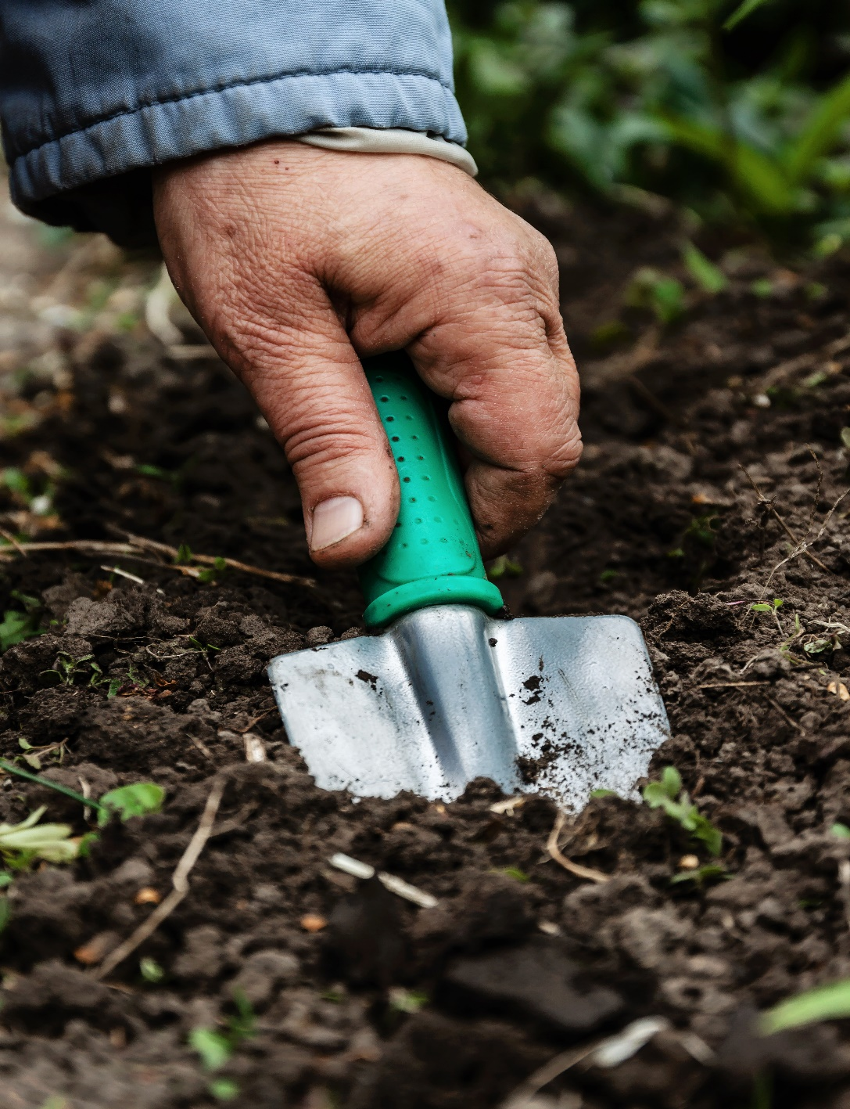
June 5 in recognition of World Environment Day “Dig in the earth, dig in your heart, dig in your wallet… to support the programs that you care about!” #DigDeep
Big Dig Day
Key Messages
JUN 5 • 24 hrs | #DigDeep
Notes:
Big Dig Day is being held on June 5 in recognition of World Environment Day; which aims to deepen awareness of the need to preserve and enhance the environment. By donating to UC ANR and California 4-H, you support programs for a healthier California.
“Dig in the earth, dig in your heart, dig in your wallet… to support the programs that you care about!” #DigDeep

Slide 7
“Campaign in a Box”…coming April 15!
Schedule of communications
Graphics
Logo
Flyers
Notes:
Earlier I mentioned two tools I’ve created to help with the plans for your campaign:
8 Week Planning Guide—which offers a complete overview of building a tailored and personalized campaign from scratch. If you’re feeling confident and ready to create a campaign, this is the step by step tool to help guide you.
Campaign In A Box, which is really very similar to a social media toolkit or editorial calendar. It’s essentially a calendar that tells you when to post and what to say. There will also be a logo and branding materials available. This will be available April 15—and I will push it out via Collaborative Tools, so please keep an eye open!

Slide 8
Activities for a Successful Giving Day
Social Media – constant campaign messages throughout the day
Email – before and during your Giving Day
Incentive Prizes!
Notes:
There are many different activities you could carry out to help you build buzz and solicit donations on a giving day. And this is where your help is so critical! Here are some of what we’ll focus on:
Social Media – We need you to follow UC ANR and UC Master Gadener pages on all social media channels, and LIKE and SHARE posts. Constant reminders about our giving day, highlighting programs, success stories, giving updates, etc. Use your greatest advantage—the volunteers! Put their social media minds to work.
Emails – Blasts before and on our giving day
Incentives – Prize challenges set around goals (Sponsorships, # of new donors, $ raised, etc.)
Others:
Letters – Snail mail letters that arrive in the 1-3 days before your big day
Events – Giving day breakfasts, lunches, and rallies
Phone Calls – Asking people to donate during the day
Meetings – Consider having small group meetings for your affinity groups and other fundraising groups on your giving day schedule
PR – Sending out press releases, doing interviews on talk radio, etc.
The more activity you carry out on your giving day the better. Remember – your goal is to make sure that everyone in your network is donating as part of your day, as well as talking about the day and helping you spread the word. Your entire team should be involved in helping to build buzz and excitement for your big day, in addition to making asks through social media, the phone, in-person meetings and more.

Slide 9
More Fundamentals…
Create Goals
Keep momentum going
You Need a Team!
Big
Dig
Day
Notes:
A few more fundamentals to keep in mind
Set clear goals so that everyone on your team (including your donors) is on the same page when it comes to the days’ activities. And be specific.
Giving Days are not a “Set It and Forget It” Fundraising Tactic
Successful giving days require constant activity for the entire day. That means plan ahead for your giving day--schedule posts and emails,-- but also stay active on the day—which could include phone calls to thank donors, posting online videos, progress updates on social media… for the entire day.
You Need a Team!
In addition to our development staff, you’ll want to get your program staff involved in your fundraising efforts if you want to have the most successful giving day possible.
I also recommend you put together a “giving day committee” composed of some of your most dedicated volunteers, donors, etc. This committee should be responsible for helping your team spread the word about your big day by being active on social media, sending out e-mails, attending events (if you have them) and of course, making a donation to support your giving day campaign.

Slide 10
GOALS
Notes:
One of the fundamentals of a successful campaign is to set goals—both monetary, as well as other important factors in our fundraising plan. So we’ve set 4 goals for this first time campaign…

Slide 11
Goal #1
County & Program participation
Notes:
Goal 1: We’re all in! 100% participation!

Slide 12
Goal #2
5
(or more!)
gifts per County
Notes:
Goal 2: 5 (or more!) gifts per County. For some this is easy, for some it’s a stretch goal. So do what you can!

Slide 13
Goal #3
$50,000
(or more!)
statewide
Notes:
Goal 3: $50,000 (or more!) statewide—that’s less than $1,000 per county! This is very attainable!

Slide 14
Goal #4
Counties/Programs that secure your own Sponsorship…
will be “boosted” by UC ANR!
Notes:
Goal 4: For Counties/Programs to secure your own Sponsorships. And if you do, your campaign will be “boosted” by UC ANR!
So that leads me to tell you about incentive prizes we’ve created for this campaign….

Slide 15
Incentive Prizes
SPONSORSHIP CHALLENGE
We'll award $250 to the first 20 county/programs that secure your own sponsor gift of $500 or more.
DONOR CHALLENGE
We'll award $500 to the county/program that has the greatest number of NEW donors.
FUNDS RAISED CHALLENGE
50 seed packets to each county/program that generates $500+ in donations by 11:59 p.m.
Notes:
We have 3 Incentive prizes available—and you can win all 3!
SPONSORSHIP CHALLENGE: We'll award $250 to the first 20 county/program that secures your own sponsor gift of $500 or more.
That means, that you ask an individual, or business, or support group to make a donation; UC ANR gives you a boost of $250! Then you can recognize that donor through your social media campaign, you could promote that gift as a matching gift to motivate other donors, etc.
DONOR CHALLENGE: We'll award $500 to the county/program that has the greatest number of new donors.
That means, the county/program that receives the greatest number of gifts—made by FIRST TIME donors—UC ANR gives you a $500 prize!
FUNDS RAISED IN A CAMPAIGN: 50 seed packets to each county/program that generates $500+ in donations by 11:59 p.m.
That means, the county/program that raises $500 or more will receive 50 custom designed UC ANR wildflower seed packets to use in your program!

Slide 16
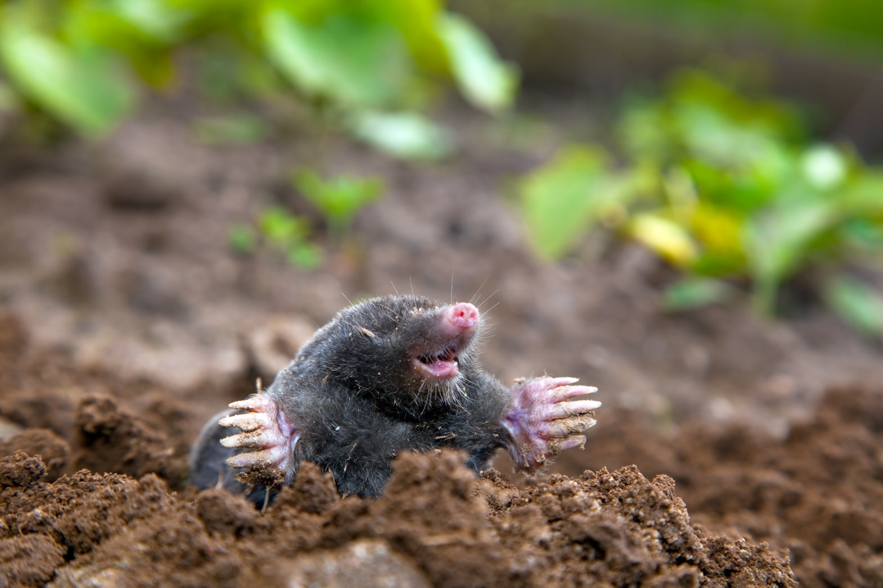
Questions?
Notes:
That was a lot of info, very quickly! So I’m happy to answer any questions!

Slide 17
Thank you!
Big
Dig
Day
JUN 5 • 24 hrs | #DigDeep
Notes:
Thank you! I’ve included my contact information in the notes of this presentation. So feel free to reach out with any questions!
Emily Delk
Director of Annual Giving & Donor Stewardship Programs
530-750-1346
eddelk@ucanr.edu

